Slide 1
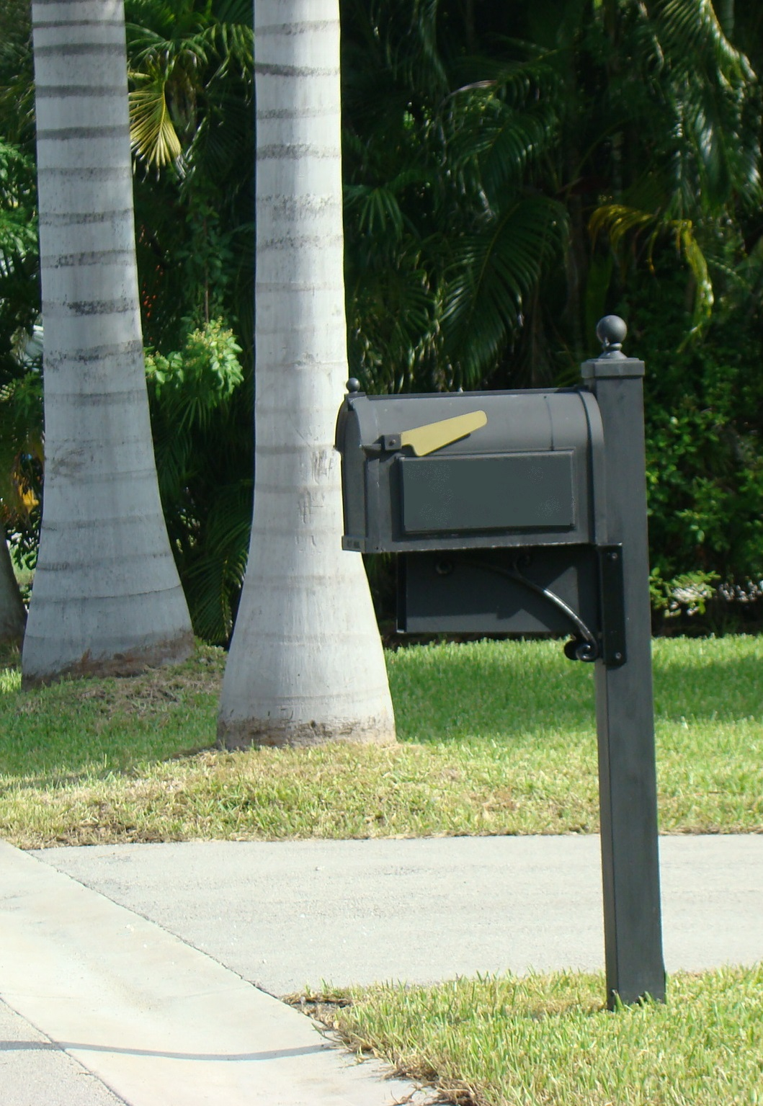
LANDSCAPE
ORDINANCE
REVIEW MEETING
THURSDAY, MARCH 31, 2016
10:00AM
TOWN HALL
Open to the Public
Town Councilmembers
may be in attendance
Stay Informed

