Slide 1
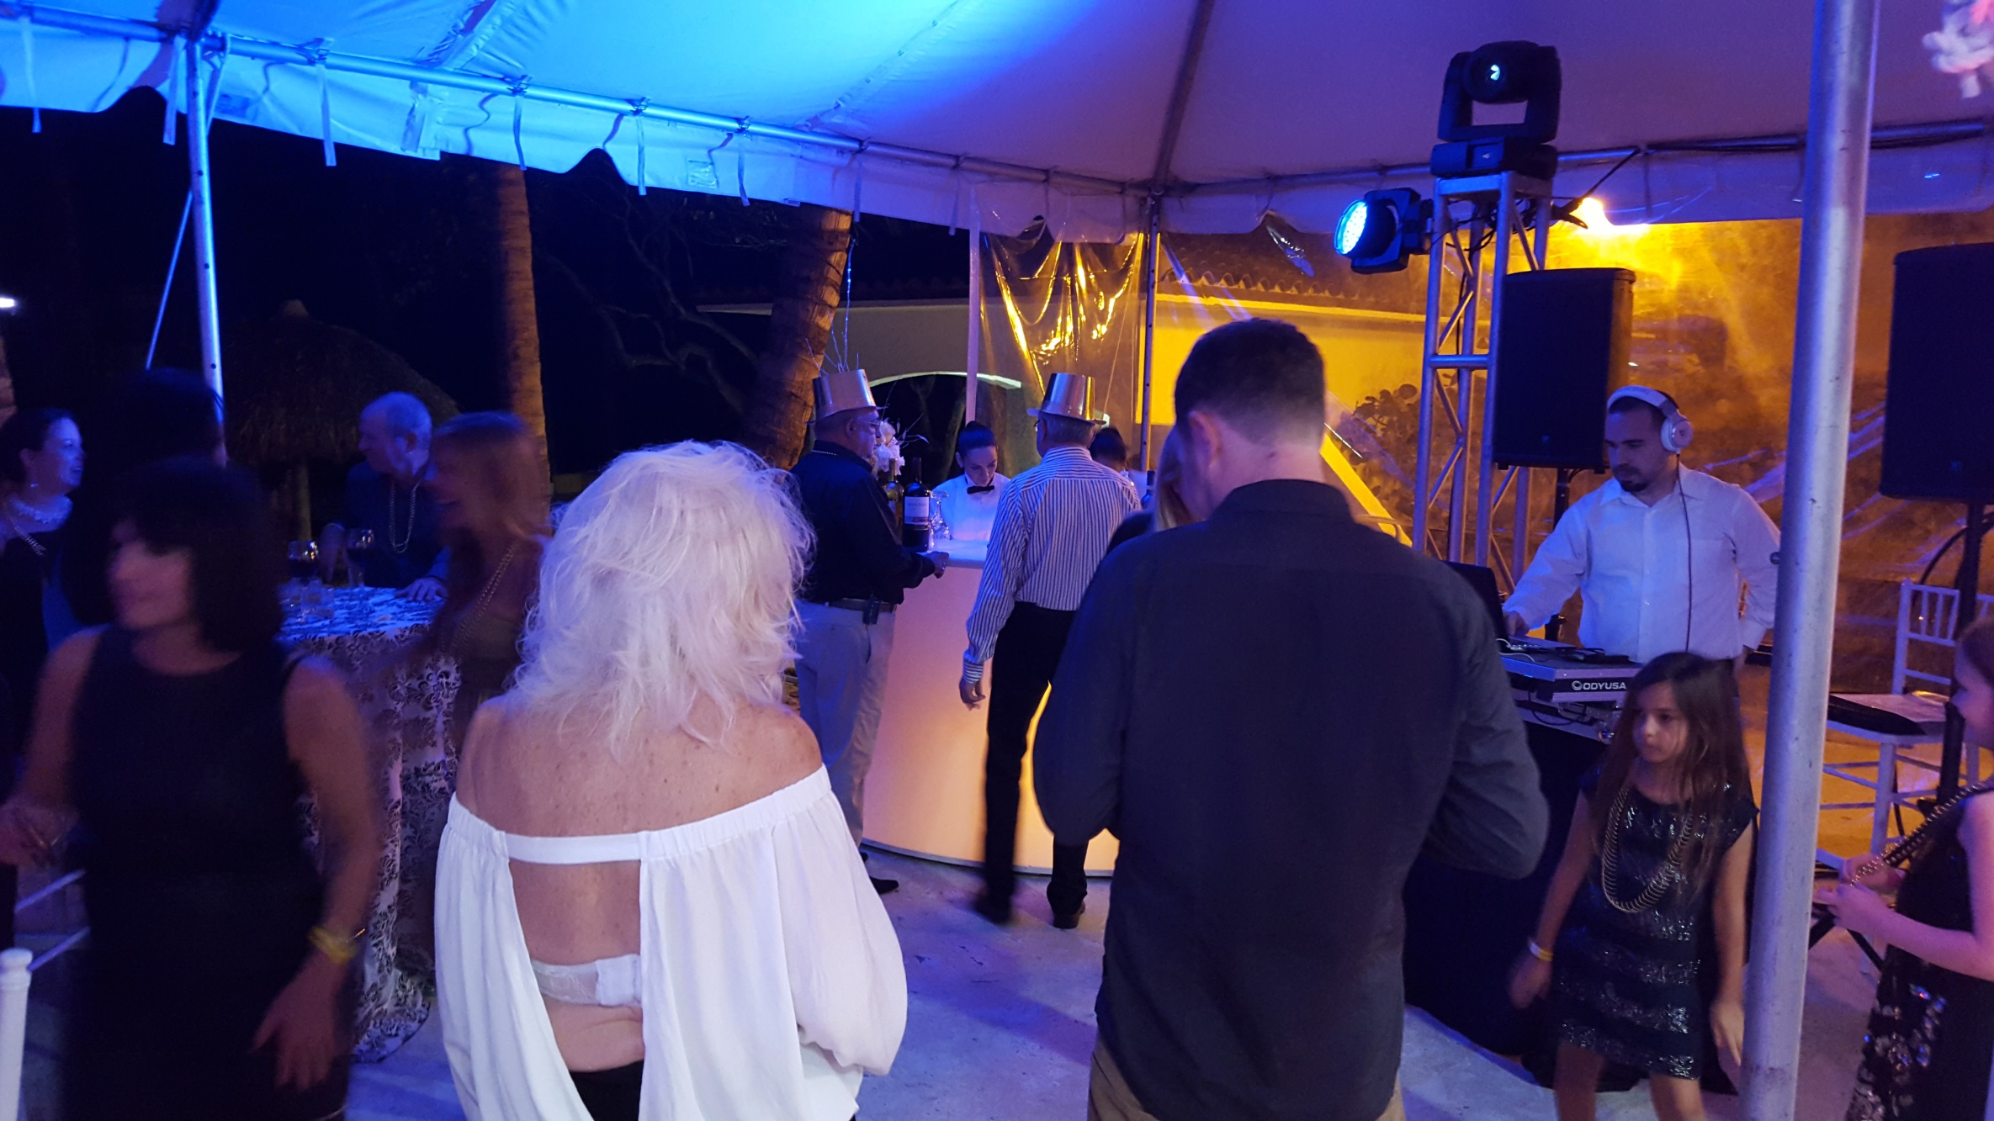
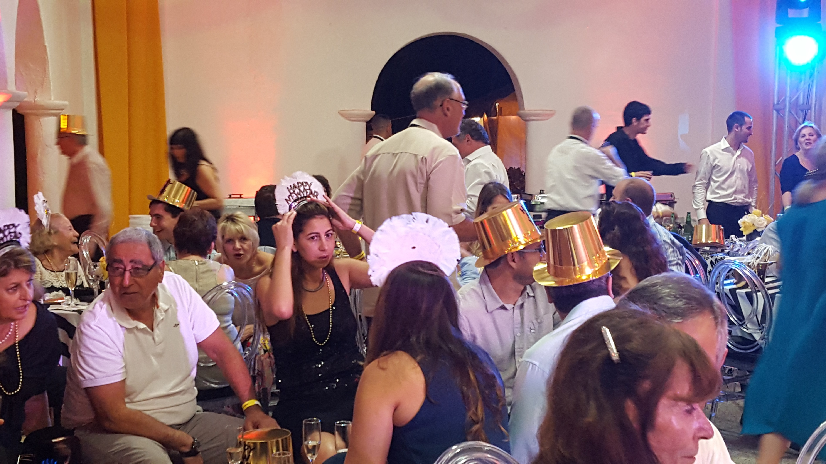
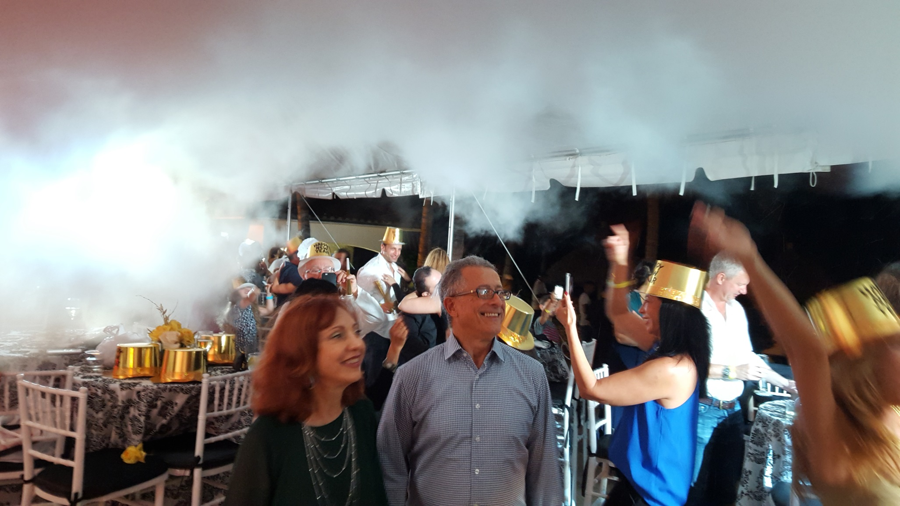
Celebration
GOLDEN BEACH RESIDENTS CELEBRATE AT
THE ARTISTS BALL NEW YEARS EVE PARTY

