Slide 1
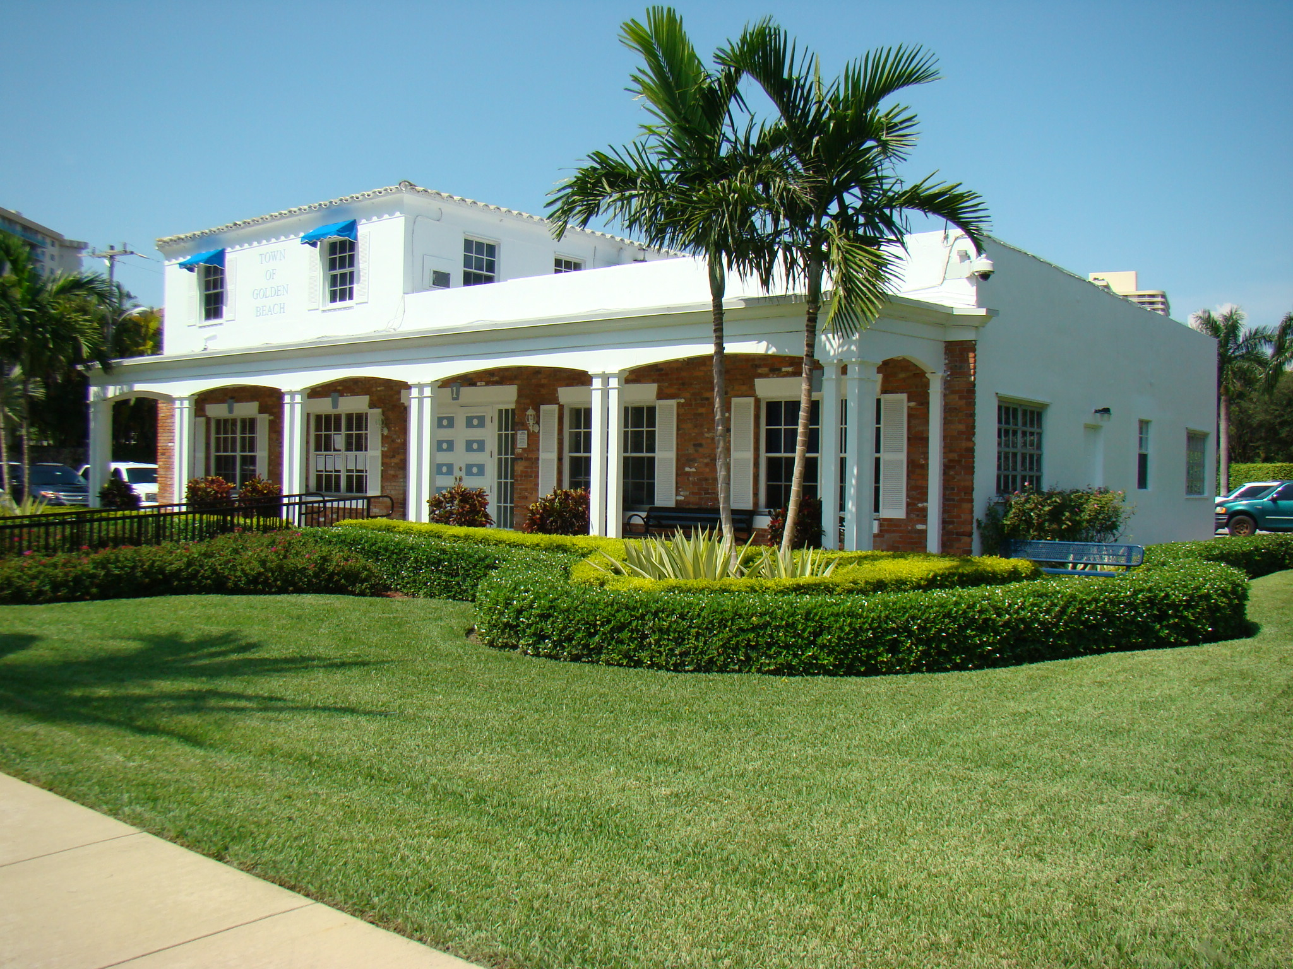
REGULAR TOWN COUNCIL MEETING
TUESDAY, MARCH 21, 2017 at 7PM
Town Hall
Making a Difference

