Slide 1
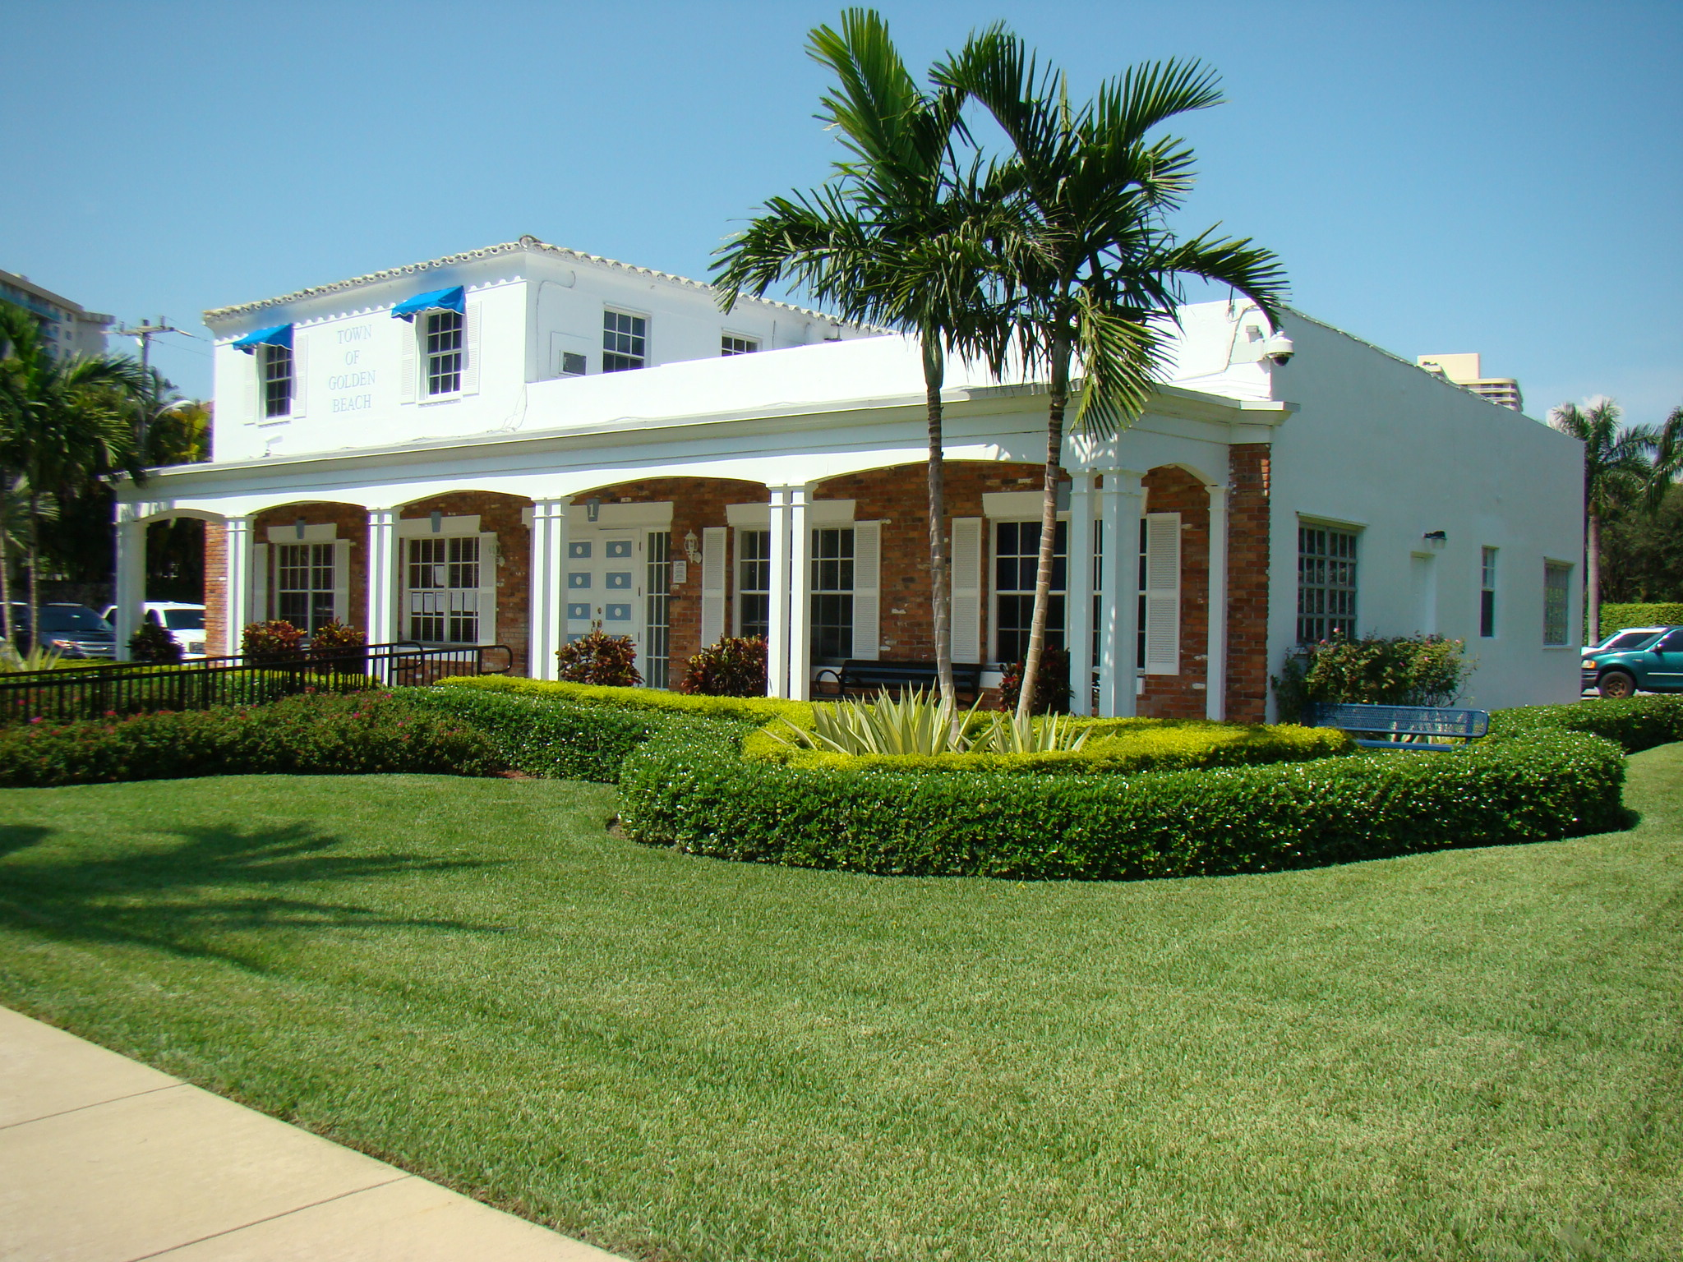
SPECIAL TOWN COUNCIL ZOOM VIRTUAL MEETING*
TUESDAY, April 26, 2022 at 6:00 PM
*PLEASE NOTE: Due to health and safety concerns as a result of the ongoing pandemic, The Town has made adjustments
to how meetings are presented. The Town Council and Administration will hold a physical Town Council meeting this month,
with very limited and socially distanced options for Residents to join physically due to spatial restrictions.
The Town STRONGLY encourages Residents to continue to participate via the ZOOM virtual platform.
Meeting ID: 874 7012 8754
Password: 154409
Audio Call: (929)205-6099
For Online Video call - visit the link below:

Slide 2
https://us02web.zoom.us/j/87470128754?pwd=aVpvWndoempHRlBFZ3M5b0hQb0ltUT09
Meeting ID: 874 7012 8754
Passcode: 154409

Slide 3
REGULAR TOWN COUNCIL ZOOM VIRTUAL MEETING*
TUESDAY, April 26, 2022 at 6:00 PM
*PLEASE NOTE: Due to health and safety concerns as a result of the ongoing pandemic, The Town has made adjustments
to how meetings are presented. The Town Council and Administration will hold a physical Town Council meeting this month,
with very limited and socially distanced options for Residents to join physically due to spatial restrictions.
The Town STRONGLY encourages Residents to continue to participate via the ZOOM virtual platform.
Meeting ID: 874 7012 8754
Password: 154409
Audio Call: (929)205-6099
To Join the Video Call, Visit the Link Below:
https://us02web.zoom.us/j/87470128754?pwd=aVpvWndoempHRlBFZ3M5b0hQb0ltUT09

Slide 4
SPECIAL TOWN COUNCIL ZOOM VIRTUAL MEETING*
TUESDAY, April 26, 2022 at 6:00 PM
*PLEASE NOTE: Due to health and safety concerns as a result of the ongoing pandemic, The Town has made adjustments
to how meetings are presented. The Town Council and Administration will hold a physical Town Council meeting this month,
with very limited and socially distanced options for Residents to join physically due to spatial restrictions.
The Town STRONGLY encourages Residents to continue to participate via the ZOOM virtual platform.
Meeting ID: 874 7012 8754
Password: 154409
Audio Call: (929)205-6099
To Join the Video Call, Visit the Link Below:
https://us02web.zoom.us/j/87470128754?pwd=aVpvWndoempHRlBFZ3M5b0hQb0ltUT09

