Slide 1


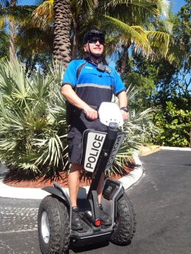
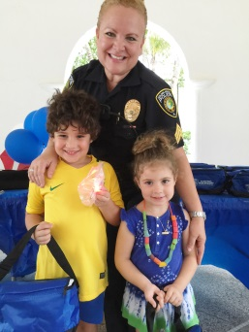
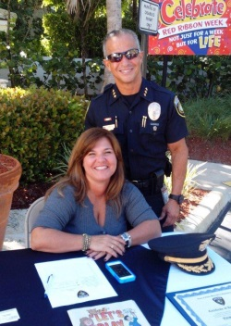


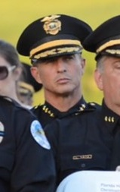
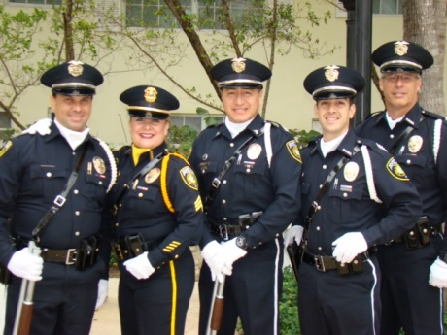
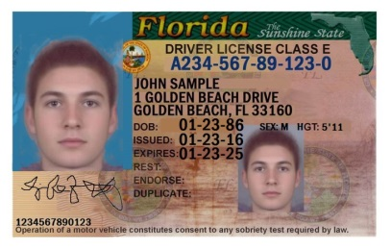
NATIONAL POLICE NIGHT OUT
Tuesday, August 6, 2024 6 - 8PM
The Strand Boat Dock
Join the Golden Beach Police Department for a special ice cream social.
Meet your Law Enforcement Officers and Command Staff and enjoy some tasty treats.
Looking for a simple way to renew or update your license?
The Department of Motor Vehicles will have their Florida Licensing On Wheels (FLOW) Service on the third floor of the new Civic Center on Monday, August 19, 2024 from 10:00AM to 2:00PM.
Appointments are REQUIRED and space is limited.
Contact Patricia at Town Hall 305-932-0744 x231 for more information
and to reserve your spot.
Proof of Identification is REQUIRED. For a full list of necessary documents:
Please visit https://www.flhsmv.gov/driver-licenses-id-cards/what-to-bring/
For Fee Information:
Please visit https://www.flhsmv.gov/fees/

