Slide 1

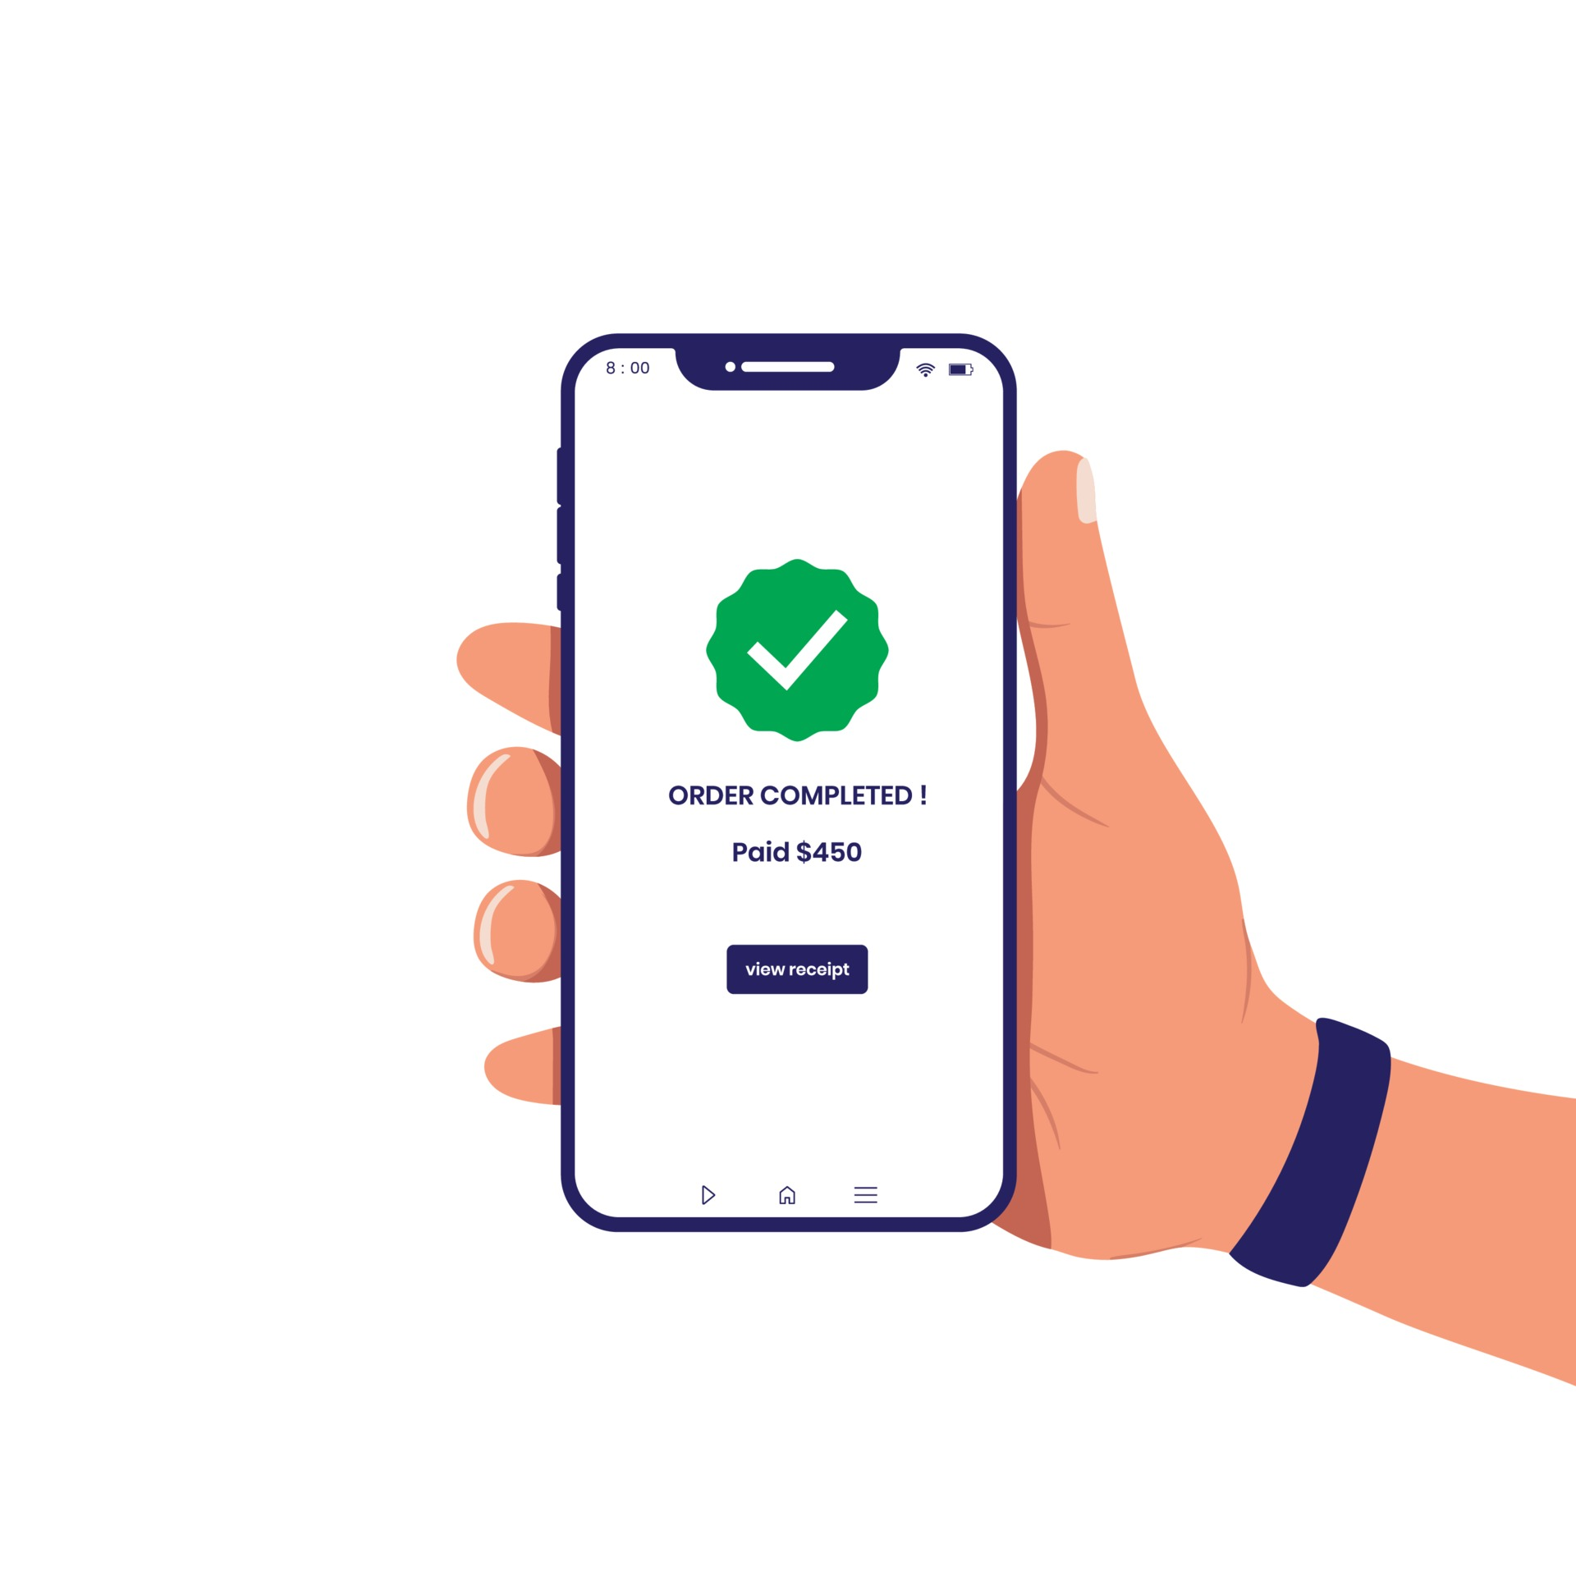


The Town of Golden Beach continues to advance how we connect.
E-MAIL RESIDENTSERVICES@GOLDENBEACH.US TO REGISTER
FOR AMENITIES & COMMUNICATION.
Communicate with your Neighbors and Town Staff
Use Bulletin Boards to share info and find activity partners
Access Town Information, including forms and libraries
Make Reservations for Tennis Courts & Recreation Spaces
FOR SECURITY.
Stay connected in case of Emergency
Register for Town IDs and vehicle transponders
Get “key fob” access to Resident-Exclusive areas including
the Beach Pavilion, Tennis Courts, Pedestrian Gates & More!

